Slide 1
CS-Studio: Setting up

Slide 2
VirtualBox
Install virtualbox 4.3
https://www.virtualbox.org/wiki/Download_Old_Builds_4_3

Slide 3
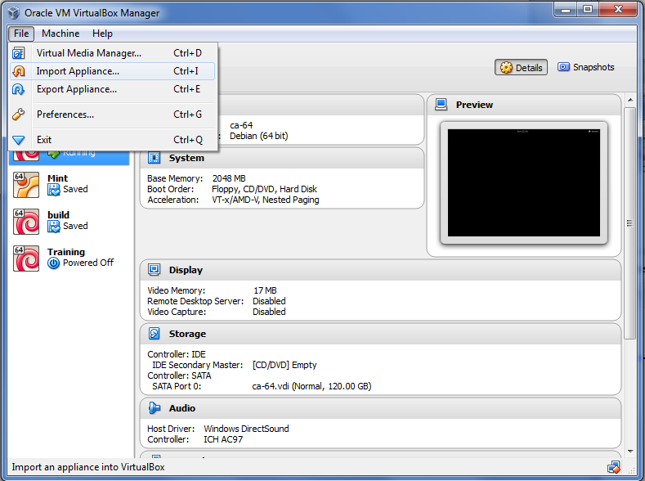
VirtualBox
File → Import Appliance

Slide 4
Login
User account info:
User train
Username: train
Password: train
User root
Username: root
Password: train
Information for the other user accounts can be found under /home/train/AccountInfo

